Slide 1
Query Likelihood Model

Slide 2
Content
The Aim of this project
Overview of the techniques used in the project
Code
Output
Conclusion

Slide 3
The Aim of this project
The aim of this project is to build retrieval systems using the query likelihood model, which will show the percentage of the probability of the query being in each file.

Slide 4

Overview of the techniques used in the project
Query Likelihood:
Removes all punctuations from a string.
Stopping word
Tokenization
Stemming/Lemmatization

Slide 5
Implementation

Slide 6
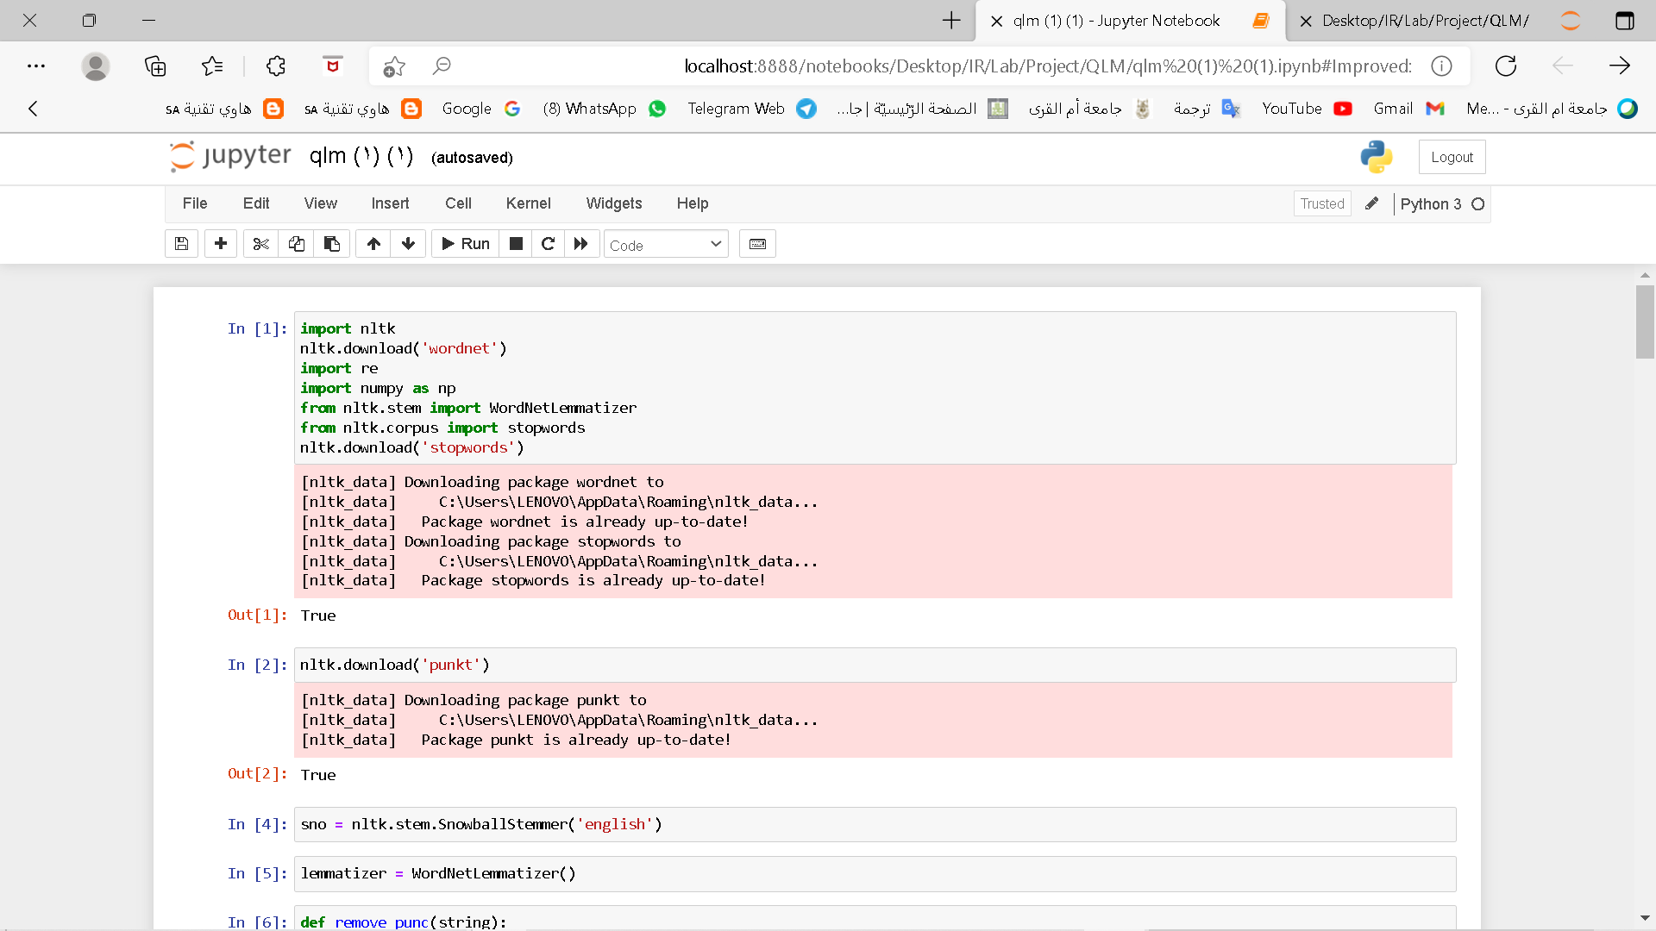
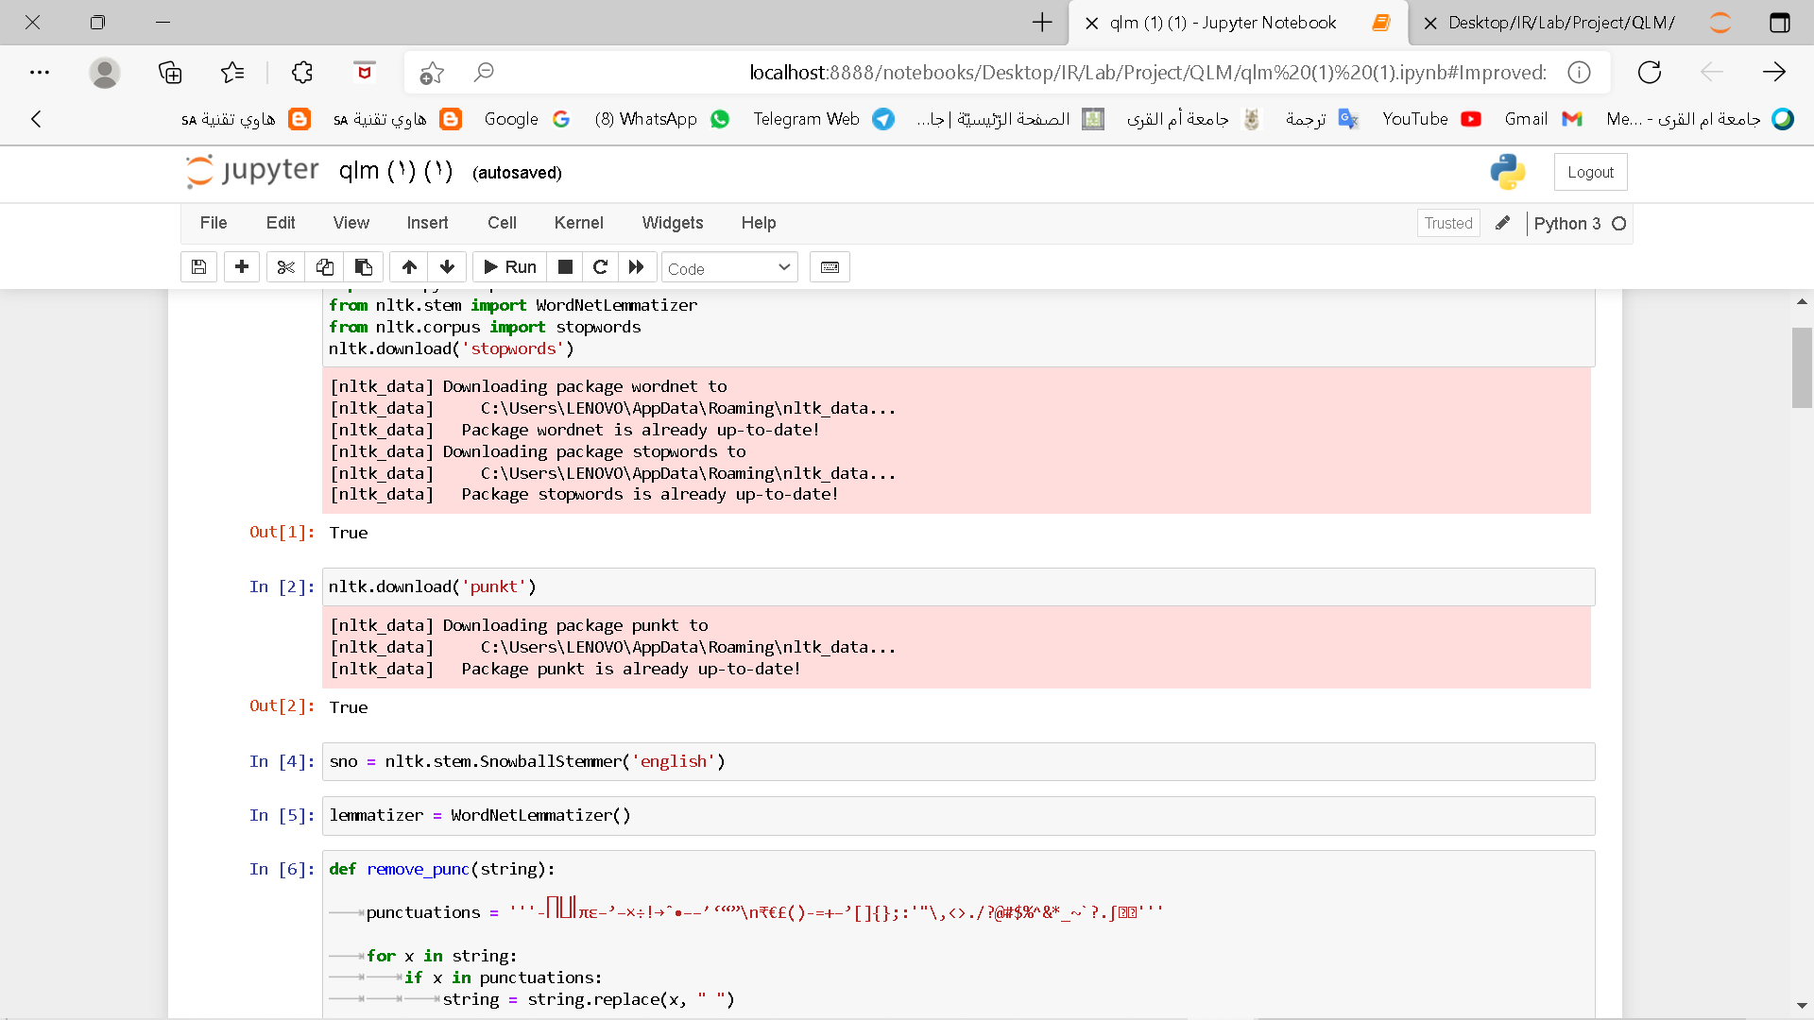
Code
First, we need to initialize and import all the libraries we need in the code.

Slide 7
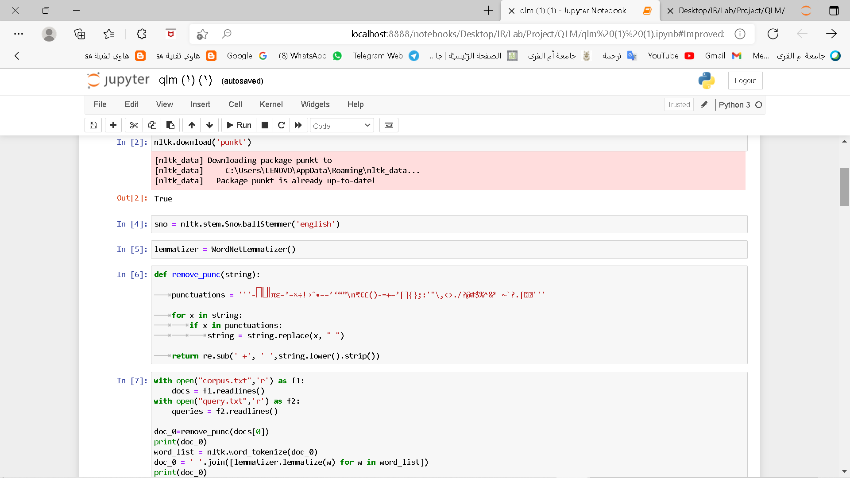
Code
Then we start by defining some of the functions we want to use on the documents.

Slide 8
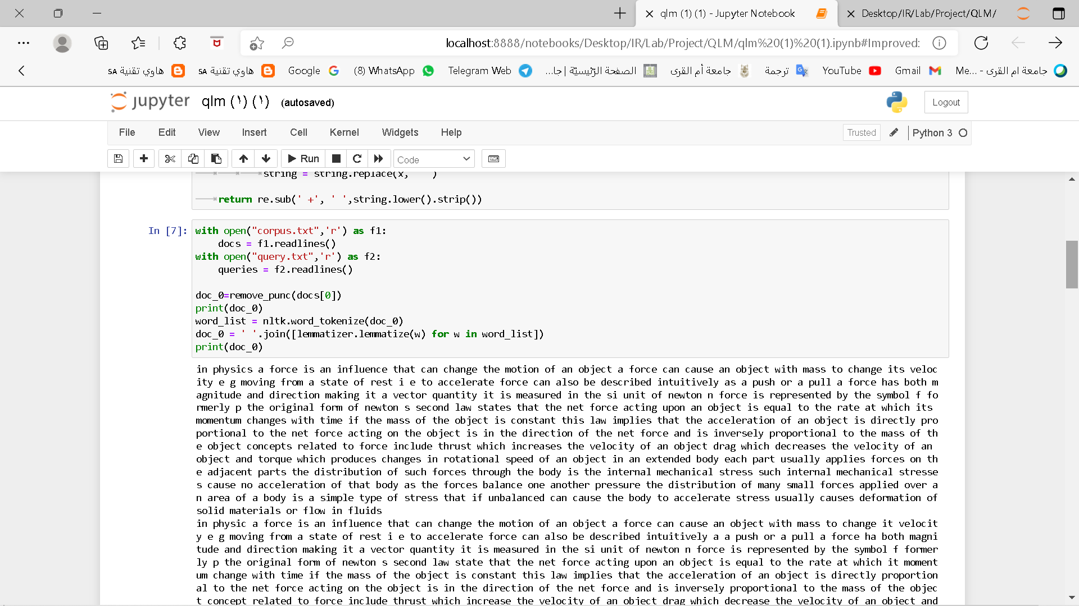
Code
At this point we will start reading the files.

Slide 9
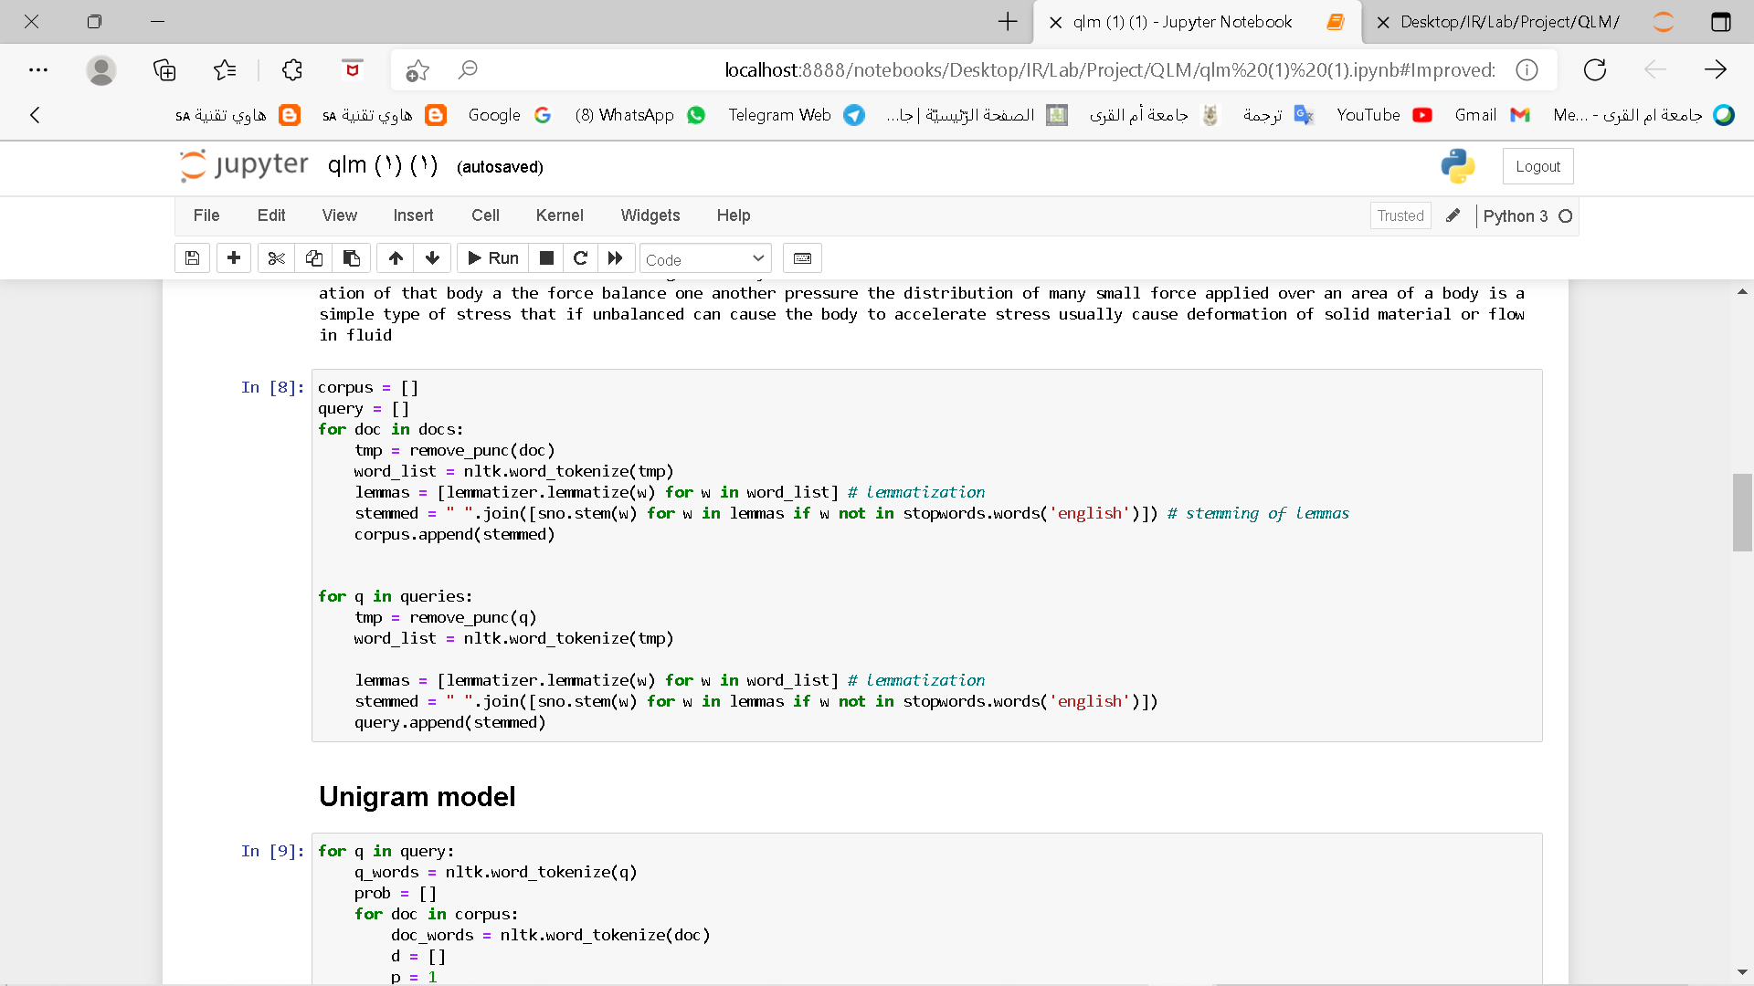
Code

Slide 10
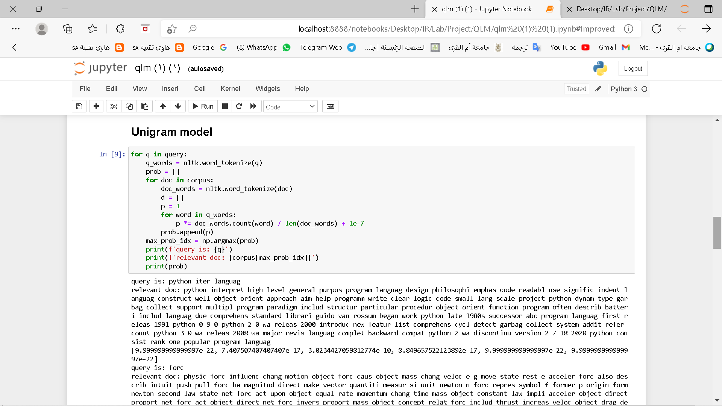
Unigram Model
Now we start executing Query Likelihood Model.

Slide 11
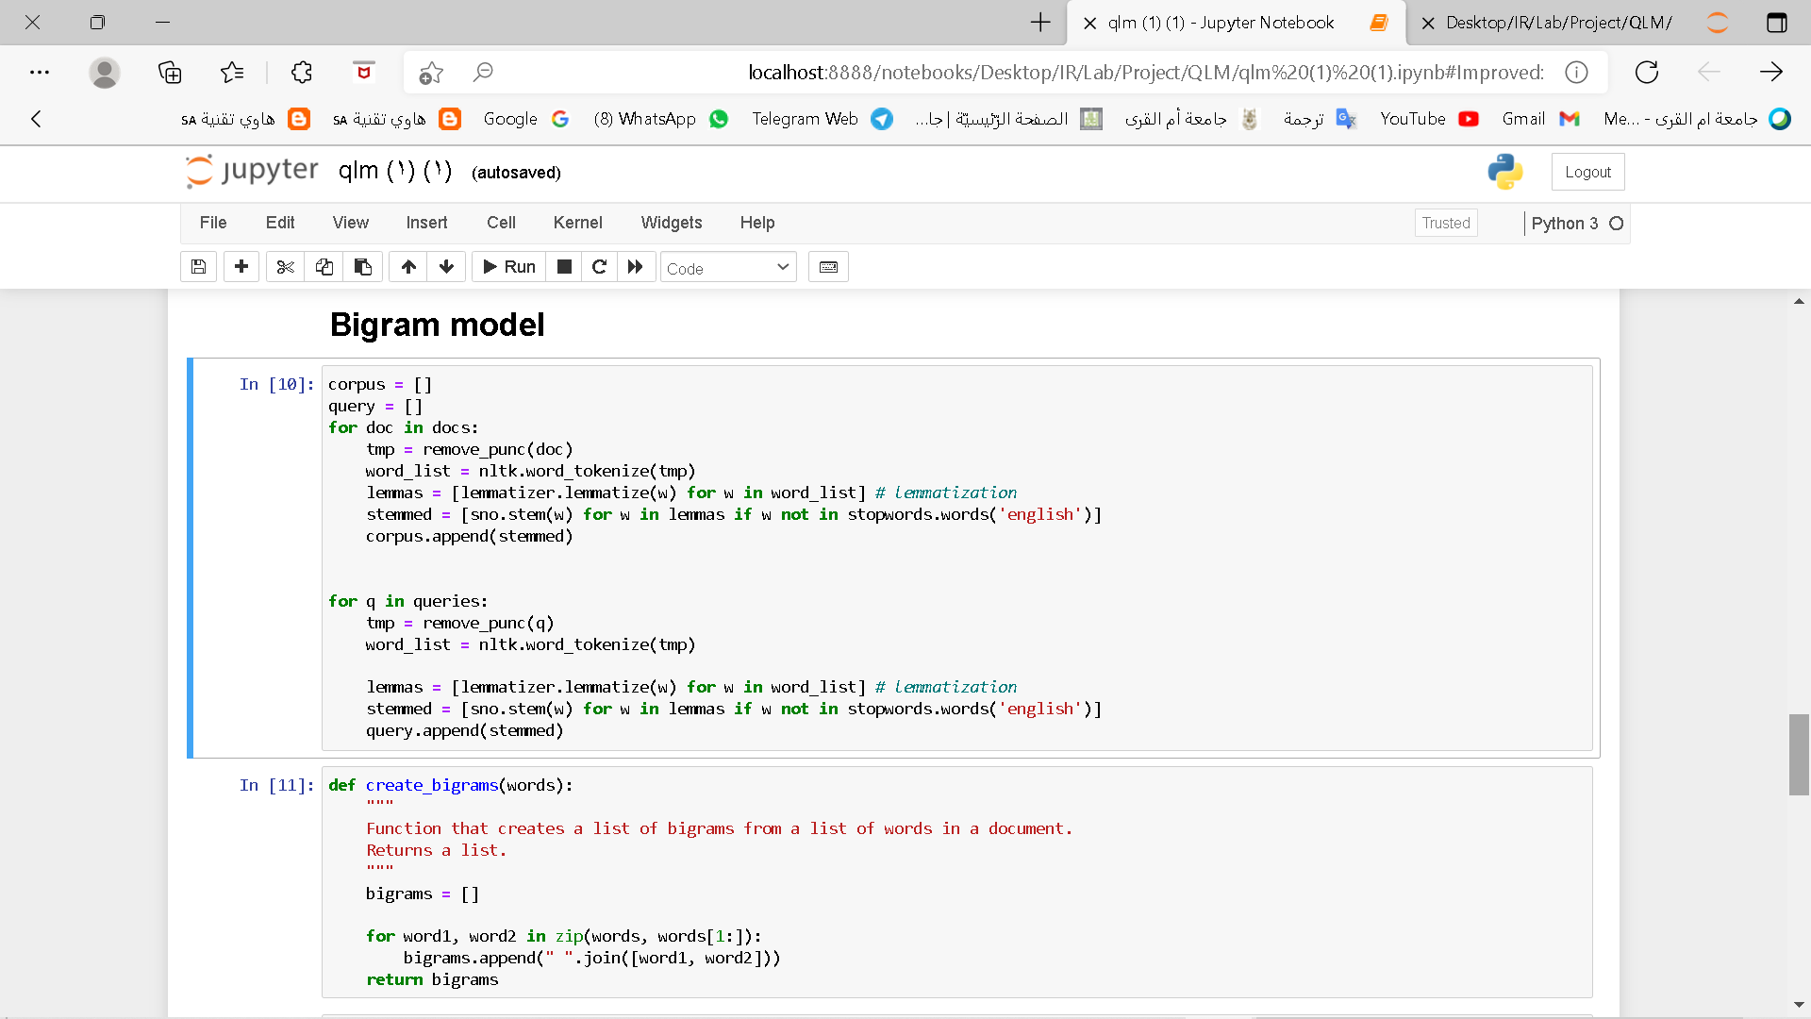
Bigram model

Slide 12
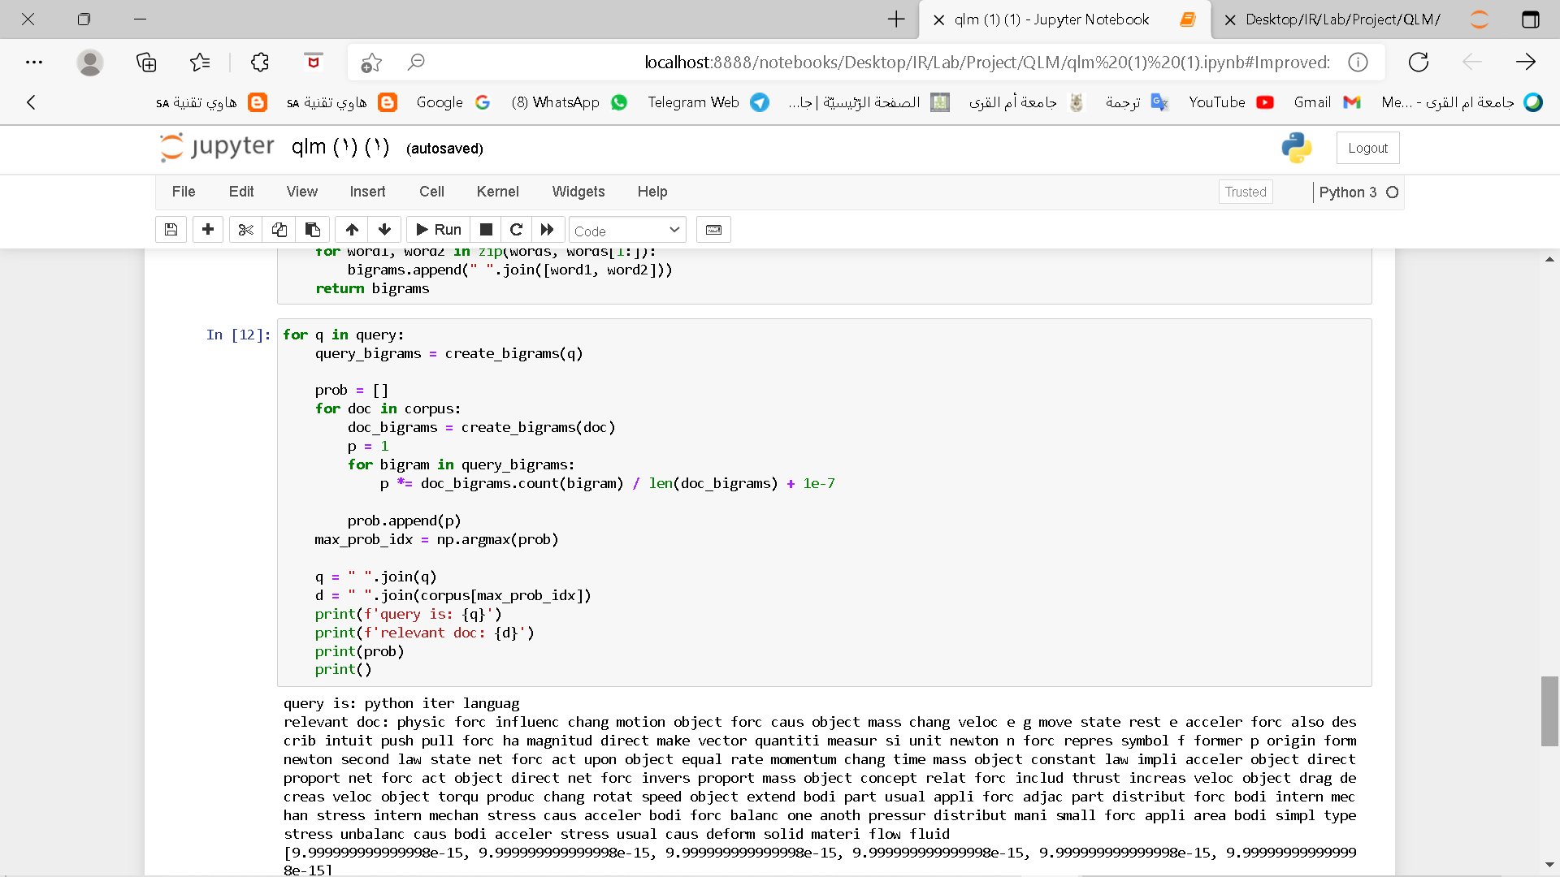
Bigram model

Slide 13
The Query
python is an iterative language
Force
Thermodynamics
World War 2 is a historic event
nuclear bomb

Slide 14
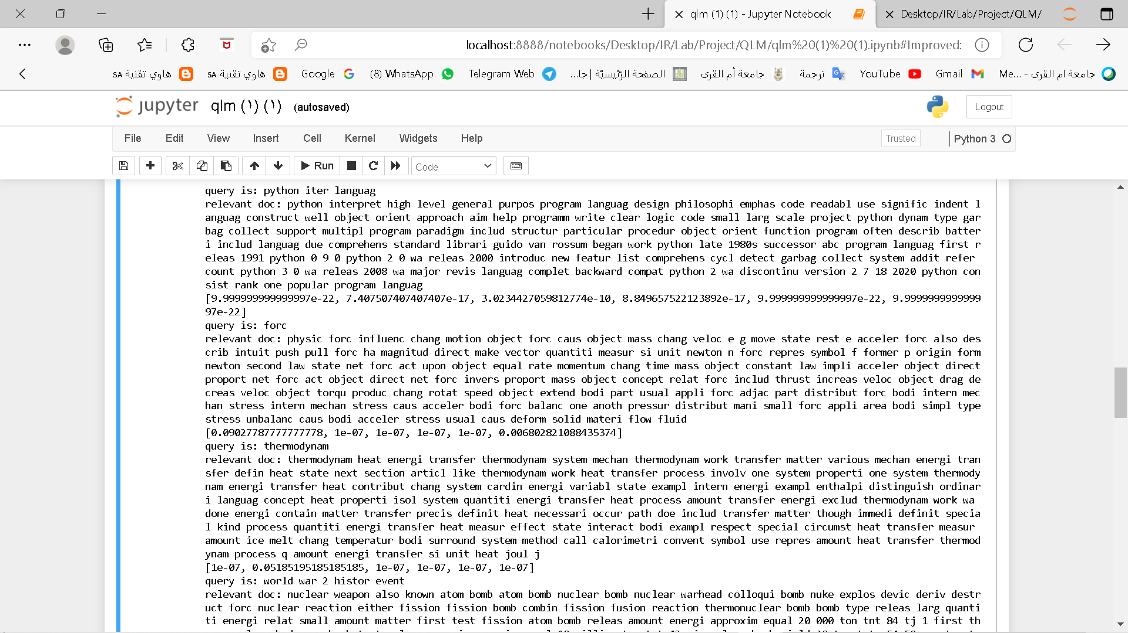
Output
The outputs for Unigram

Slide 15
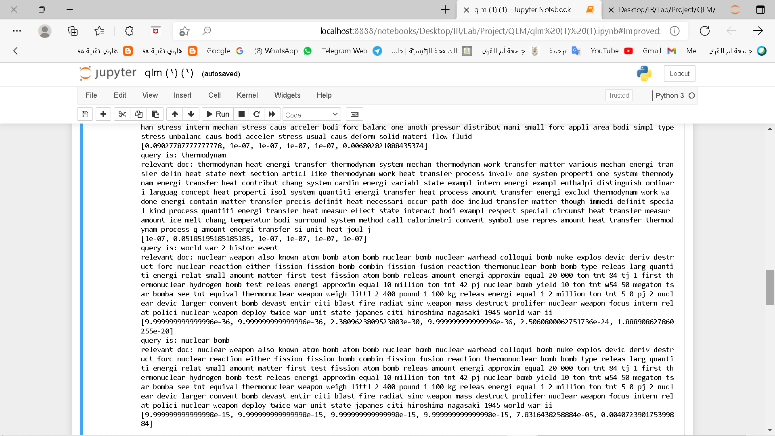
Output

Slide 16
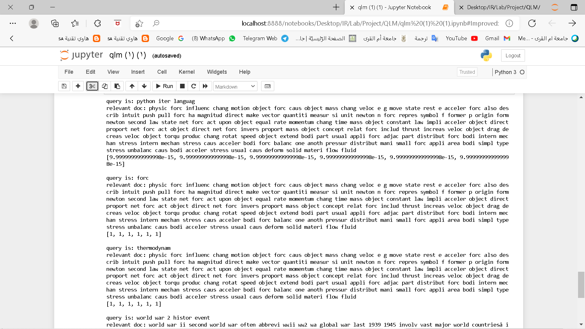
Output
The outputs for Bigram

Slide 17
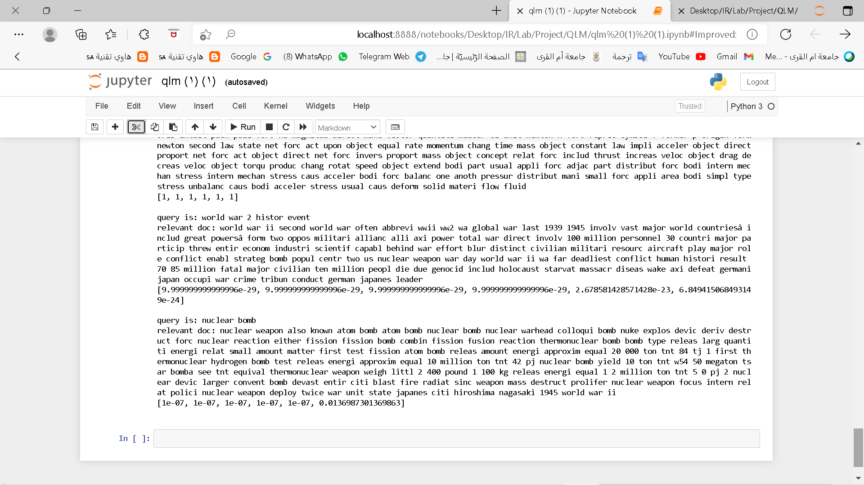
Output

Slide 18
Conclusion
We have seen in this project the results of our application model, so we conclude from that the Unigram for these queries is much better than the use of Bigram.
We also see that not all the results for Bigram are correct, knowing that writing the code and the query are correct, which means that spars diagram probability occurs.

Slide 19
Thank you!

